Slide 1
GIS part Urban Cadastral Surveying and Mapping
Practical on Urban cadaster

Slide 2
GIS data organization
Recap
(shapefile and Geodatabase)

Slide 3
A database
GIS data organization
Spatial (Geographic) database is simply databases containing geographic data for a particular area and subject or a collection of spatial data that acts as a model of reality.
Cadaster database ?

Slide 4
GIS File Data Formats
GIS data organization
In the GIS world, there are many different GIS file formats.
For this training/sector, we will focus on:
shapefiles for vector data,
imagine and GeoTiff files for rasters and
file geodatabases for both vector and raster data.

Slide 5
Vector Data File Formats Shapefile
GIS data organization
A shapefile is a file-based data format native to ArcView 3.x software.
A shapefile is a feature class–it stores a collection of features that have the same geometry type (point, line, or polygon), the same attributes, and a common spatial extent.
A “single” shapefile is actually composed of at least three files, and as many as eight.
Each file that makes up a “shapefile” has a common filename but different extension type.

Slide 6
files that define a “shapefile”
GIS data organization
File extension | Content
.dbf | Attribute information
.shp | Feature geometry
.shx | Feature geometry index
.aih | Attribute index
.ain | Attribute index
.prj | Coordinate system information
.sbn | Spatial index file
.sbx | Spatial index file
Note that each file has a specific role in defining a shapefile.
E.g.
Kebele.dbf
Kebele.shp
Kebele.shx
Kebele.prj

Slide 7
File Geodatabase
GIS data organization
A file geodatabase is a relational database storage format.
It’s a far more complex data structure than the shapefile and consists of a .gdb folder housing dozens of files.

Slide 8
!
Sample content of an ArcGIS file geodatabase

Slide 9
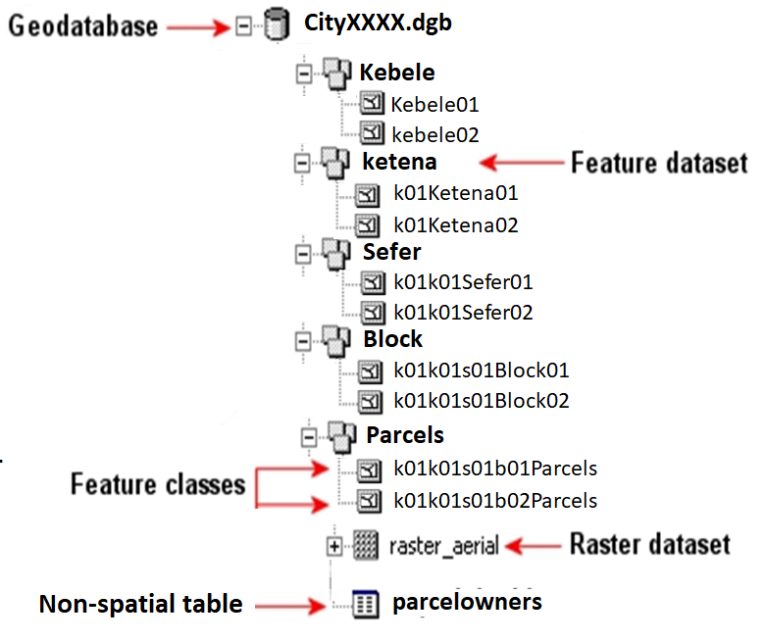
GIS data organization

Slide 10
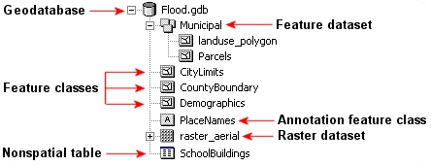
Sample content of an ArcGIS file geodatabase
GIS data organization

Slide 11
Data quality
GIS data organization
An error is something you have done that is considered to be incorrect or wrong, or that should not have been done.
Error can be related with
Attribute, and/or
Location
Errors created by faulty processing.
Errors created by human error.
Errors from obvious sources (e.g. incomplete maps)
Errors created during data input (e.g. digitizing).
Errors created by map projection.

Slide 13
Managing GIS Files
Unless you are intimately familiar with the file structure of a GIS file, it is best to copy/move/delete GIS files from within the software environment.
ArcCatalog (part of the ArcGIS suite) acts like a Windows file management environment with the added benefit that it recognizes GIS files.

Slide 14
ArcCatalog
The ArcCatalog application provides a catalog window that is used to organize and manage various types of geographic information for ArcGIS for Desktop

Slide 15
ArcCatalog is used to organized & managed
Geodatabases
Raster files
Map documents, layer files
Geoprocessing toolboxes
And much more
Notes:
The kinds of information that can be organized and managed in ArcCatalog
Geodatabases
Raster files
Map documents, globe documents, 3D scene documents, and layer files
Geoprocessing toolboxes, models, and Python scripts
GIS services published using ArcGIS for Server
Standards-based metadata for these GIS information items
And much more

Slide 16
ArcCatalog is used to
Organize your GIS contents
Manage geodatabase schemas
Search for and add content to ArcGIS applications
Document your contents
Manage GIS servers
Manage standards-based metadata

Slide 17
ArcMap
is the main component of Esri's ArcGIS suite of geospatial processing programs,
is used primarily to view, edit, create, and analyze geospatial data.
allows the user to explore data within a data set, symbolize features accordingly, and create maps.

Slide 18
Practical with the GIS software
Getting started with ArcCatalog in focus with exploring existing cadastral data
Getting started with ArcMap Interface for displaying and interacting with existing cadastral features (orthophoto and vector features)
Exploring and understanding GIS data organization using shape file and geodatabase approach
Working with file geodatabase (feature dataset, feature class, topology, advanced editing, …)

Slide 20
Getting started with ArcCatalog
!
in focus with exploring existing cadastral data
Page 68 - 72

Slide 21
Working with ArcCatalogue
+
ArcCatalogue
Start
GUI = Graphic User Interface
Connect to folder (workspace)
Explore and preview data
Metadata
Spatial data
Attribute data
Disconnect folder

Slide 22
Structure of the file geodatabase
+

Slide 23
GIS data organization
+

Slide 24
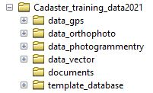
Existing data organization
+

Slide 25
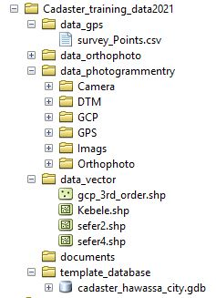
Subfolders
+

Slide 26
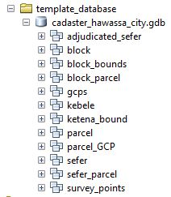
Sample cadaster database feature dataset
+

Slide 27
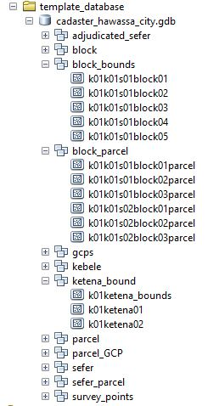
Sample cadaster database feature dataset feature class

Slide 28
Working with ArcMap - start
+
ArcMap
Start
GUI = Graphic User Interface
Connect to folder (workspace)
Check the contents of the
folders / databases

Slide 29
Working with ArcMap – Add data
+
Add data/file
Table of content management
View data
Change order
Use toolbars / buttons
Zoom in / zoom out/ pan
Open table of a layer and preview the contents
Select / deselect (layer / attribute)

Slide 30
Working with ArcMap – project
+
Project
Save
Close
Restart

Slide 31
Working with ArcMap – new project
+
Project – new
Connect folder from catalogue in ArcMap
Check the contents of folders and database
Add selected layers: raster, vector
Properties of a layer
Change symbol of a layer
Save project

Slide 32
Working with ArcMap – toolbars / panels
+
Toolbars
Panels
Close unnecessary toolbars/panels
Change position of toolbars
Arrange the toolbars properly

Slide 34
Getting started with ArcMap
!
Interface for displaying and interacting with existing cadastral features (orthophoto and vector features)

Slide 35
Urban Legal Cadastre Standard
No. – 03/2015 Addis Ababa

Slide 36
Cadastral Data Standard (see chapter Two of Urban Legal Cadastre Standard , No. – 03/2015 , Addis Ababa)
For preparing a cadastre base map, only the following data sources shall be used (the spatial component (parcel map) of the data should be obtained using the following techniques)
Ground surveying
Aerial photography
High resolution satellite imagery (Refer to Urban Cadastral Surveying Directive article 37 (6))

Slide 37
Cadastral Data Standard (see chapter Two of Urban Legal Cadastre Standard , No. – 03/2015 , Addis Ababa)
For preparing a cadastre base map, only the following data sources shall be used (The non-spatial (descriptive) information should be obtained from):
Existing Legal Documents
Field Observation
Other Data Sources

Slide 38
Cadastral Data Standard (see chapter Two of Urban Legal Cadastre Standard , No. – 03/2015 , Addis Ababa)
The following data can also be useful in preparing cadastral maps:
Local development plan (LDP)
Survey Plans
Existing base maps

Slide 39
Feature Extraction
When ortho-photo is used as data source in preparing cadastral map, the feature extraction method must be primarily using photogrammetric technique (stereo compilation method).
But as an option, on-screen/heads-up digitizing can also be used provided that the capture scale is kept constant at scale of 1:500 for 1:2000 scale output.

Slide 40
Feature Extraction
While digitizing a parcel boundary from aerial photograph, centerline of a boundary/fence should be used whenever the sharing is between two adjacent private landholding of a parcel.
On the other hand, whenever the sharing of boundaries is with road and open public land or easement, the outer part of the boundary/fence outline shall be used.

Slide 41
Feature Extraction
Filed boundary conformation is mandatory for each parcel boundary after on-screen digitization.
Vertex should be available only at corner points of a parcel boundary where it changes its direction.
Avoid unnecessary vertex during digitization.

Slide 42
Feature Extraction
Each parcel boundary should be a closed polygon.
An entire area of a town/a project area should be covered by a parcel map including
road, streams, gullies, hills, pocket areas etc.
Not copy / paste instead merge the parcels
???

Slide 43
Feature Extraction
Thus an aggregate area of each parcels of a town should be equal to a total area of that town.

Slide 45
Datum and Map Projection System
Based on the national standard adopted by EMA, coordinates shall be calculated in reference to the grid on UTM projection and zones 36, 37, or 38 depending on the geographic location.
Projection – Universal Transverse Mercator
Spheroid/Reference Ellipsoid – Clarke1880 modified
Local Geodetic Datum – Adindan
Unit – Meter

Slide 46
Datum and Map Projection System
Projection Parameters
UTM Grid Zone – 36, 37, 38 depending up on the geographic location
Central Meridian – 33°E for zone 36; 39° E for zone 37; and 45° E for zone 38 3)
False Easting – 500,000 m E
False Northing – 0 m N
Scale Factor - 0.9996

Slide 47
Coordinate Transformation Parameters and Coordinate System
The datum transformation parameters provided by EMA shall be used for transforming the geodetic coordinates from WGS84 to Adindan geodetic datum.
In cadastral surveying and mapping activities the transformed coordinates shall be stated in Cartesian coordinate system;
The parameters to be used are:-
Semi-major axis (a): 6378249.145metre
Semi-minor axis (b): 6356514.9667metre
Ellipsoidal flattening (f):1/293.466307656

Slide 48
Coordinate Transformation Parameters and Coordinate System
Translational transformation parameters are:-
Δx = -162
Δy = -12
Δz = 206

Slide 49
Non spatial data
!

Slide 50
Unique Parcel identification code Standard (Basic Principles)
The parcel identification code shall meet the following principles:
Uniqueness -is the most important attribute of a PIN. It refers to a one-to -one relationship between a parcel and its identifier. An identifier should be assigned to one and only one parcel.

Slide 51
Unique Parcel identification code Standard (Basic Principles)
The parcel identification code shall meet the following principles:
Permanent- Parcel identifiers should be permanent and change only when absolutely necessary. This is especially important when stakeholders such as planning departments or tax payment tracking services link their own databases to the assessor's.

Slide 52
Unique Parcel identification code Standard (Basic Principles)
The parcel identification code shall meet the following principles:
Simple- Parcel identifiers should be easy to understand and use quarter-quarter-section numbers, along with individual parcel and have as few digits as possible. A parcel identifier that is uncomplicated and easily understood helps to reduce errors in its use.

Slide 53
Unique Parcel identification code Standard (Basic Principles)
The parcel identification code shall meet the following principles:
Easily Maintainable- The parcel identification system should be easy to maintain and should efficiently accommodate changes, such as splitting or merging parcels.

Slide 54
Unique Parcel identification code Standard (Basic Principles)
The parcel identification code shall meet the following principles:
Flexible -The parcel identification system should be reasonably flexible. It should be capable of serving a variety of uses:
not just land parcels, but
multi-story condominiums,
sub-surface rights, leases, easements, and so on.

Slide 55
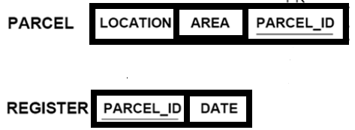
Unique Parcel identification code Standard (Basic Principles)
The parcel identification code shall meet the following principles:
Accessibility - the description about the parcel shall be accessible to the user.
Relate / join with other table such as register

Slide 56
Unique Parcel identification code Standard (Assigning Parcel Identification Code)
According to Urban Landholding Registration Proclamation No. 818/2014 Article 8, each parcel shall have a unique parcel identification code which may not be duplicated on another parcel in any urban center. For this purpose a national standard is required to assign a code for each parcel.

Slide 57
Unique Parcel identification code Standard (Assigning Parcel Identification Code)
The unique parcel identification code shall take the following form:
Region code + city/town code + + Woreda code + Neighborhood code City block number + parcel number
Region code (type= Alphabetic;2 digit)
City/Town code (type= number;3 digits)
Woreda / kebele (type= number; 2 digits)
Neighborhood (type= number; 2 digits)
City Block number code (type = number ; 2digit)
Parcel number code (type = number; 3 digit)
Total No. of digits:- 14

Slide 58
Unique Parcel identification code Standard (Assigning Parcel Identification Code)
Example:
OR001062314112
Oromiya region, Adama town, Woreda 06, Neighborhood 23, city block 14 & parcel no. 112

Slide 59
Unique Parcel identification code Standard
City/Town code: The town or city code shall be assigned by regional government urban bureau.
Condominium/Apartment code: Specific condominium units and house number should be assigned separately once the parcel (condominium site) is identified.
Thus, it is easily possible to identify by indexing the condominium to the ground parcel.

Slide 60
Unique Parcel identification code Standard
The index should take the following code:
Condominium Block unit code (type= number; 2 digit)
Condominium floor code (type= number; 2 digit)
House number code (type= number; 2 digit)
Example: OR001062314112050201=20 digits

Slide 61
Control of New Parcel Numbers
The control of the subsequent allocation, re-allocation, and withdrawal of parcel identifiers is part of the larger process of managing land-tenure changes.
There are various techniques available for monitoring the fidelity of a parcel identifier from the time of its initial assignment through subsequent processing, most of which employ the addition of a redundant check digit.
The simplest approach is the addition of a check digit at the end of an identifier, which is mathematically related to the sequence of digits in the identifier.

Slide 62
Splitting a parcel
If the configuration of a parcel is changed (e.g., typically by subdivision), that parcel ceases to exist, and new identifiers are assigned to the new parcels following the last parcel in the block.
However, the original parcel remains as a historic entity and the descriptions of it that were entered in the various registers and files when it did exist remain coded to it.
Indexes that identify such “retired” parcels must be included in the records system unless provided otherwise by statute.

Slide 63
Merging adjacent parcels
When two consecutive parcels are merged, the identification of the new parcel shall be next to the identification of the last parcel within the block.

Slide 65
Working Manual for Urban Cadastral Surveying and Mapping Based on Cadastral Surveying Directive
!
No.44/2015 Manual No: 26/2016

Slide 66
Geo-database design works
Database issues that are pertinent to the vector datasets need to be handled with knowledge.
Geo-database design works, appropriate projection, local datum, ellipsoid…etc.
Designation has to be properly managed in the geo-databases created prior to getting in to main work of editing.

Slide 67
Geo-database design works
Here, what should be taken as the basic archiving system is that both the vector and raster data should be archived systematically in such a way that every geo-database, geo-dataset, feature class, image, folder and other vector files should be given a logical name.
This is to mean that a vector data of a given neighborhood, for instance, will be given the name of the specific adjudication site when archived.

Slide 68
Geo-database design works
Naming the data with the name of a person or other unknown code would not be appropriate and bring about confusion and loss of resource and time sooner or later.

Slide 69
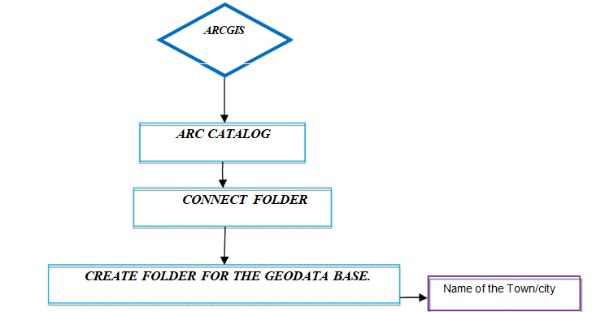
Sample Geo-database design

Slide 70
File Geo-database
It is a file folder that holds its dataset files.
Can hold many datasets.
Each data sets consists many feature classes.
Can store up to 1 TB data.
Cross platform
cannot support versioning.
single users with smaller group.
Compressed and encrypted for security purpose.

Slide 71
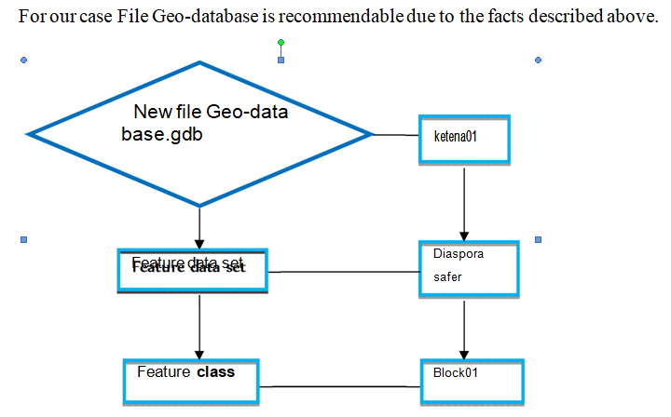
Sample spatial data archiving system

Slide 73
Examination and verification of vector data (1/4)
As the assigned surveyor/s or mapping staff begin managing the vector data by, of course, draping the vector file over the image, the first task would be naturally to examine how well the vector parcels overlap with similar features on the image.
However there may be a slight shifting since line maps was made using stereoscopic view in 3D environment and unlike the 2D desktop the line map were displayed.

Slide 74
Examination and verification of vector data (2/4)
Regarding the existing vector file, there could be some pocket areas having slight shifts, gaps and overlaps that need editing by applying both desktop GIS/Mapping and ground survey data collection and its integration with the vector data.
Vector data shall be checked for its completeness using Topology rule i.e.
Point line, and polygon topology rules will be applied.

Slide 75
Examination and verification of vector data (3/4)
Examination of the vector-image fitting and verification should be conducted at then City/town Block level.
Data verification is both manageable and helps easy identification of problem areas and accomplished works. The city/town block level map for vector image verification shall be done based on procedures stipulated at Adjudication Regulation 324 /2014 at Art 9.

Slide 76
Examination and verification of vector data (4/4)
Neighborhood-level maps should be prepared when field verification is planned. These maps will be used by both the demarcation staff and the surveyors.

Slide 77
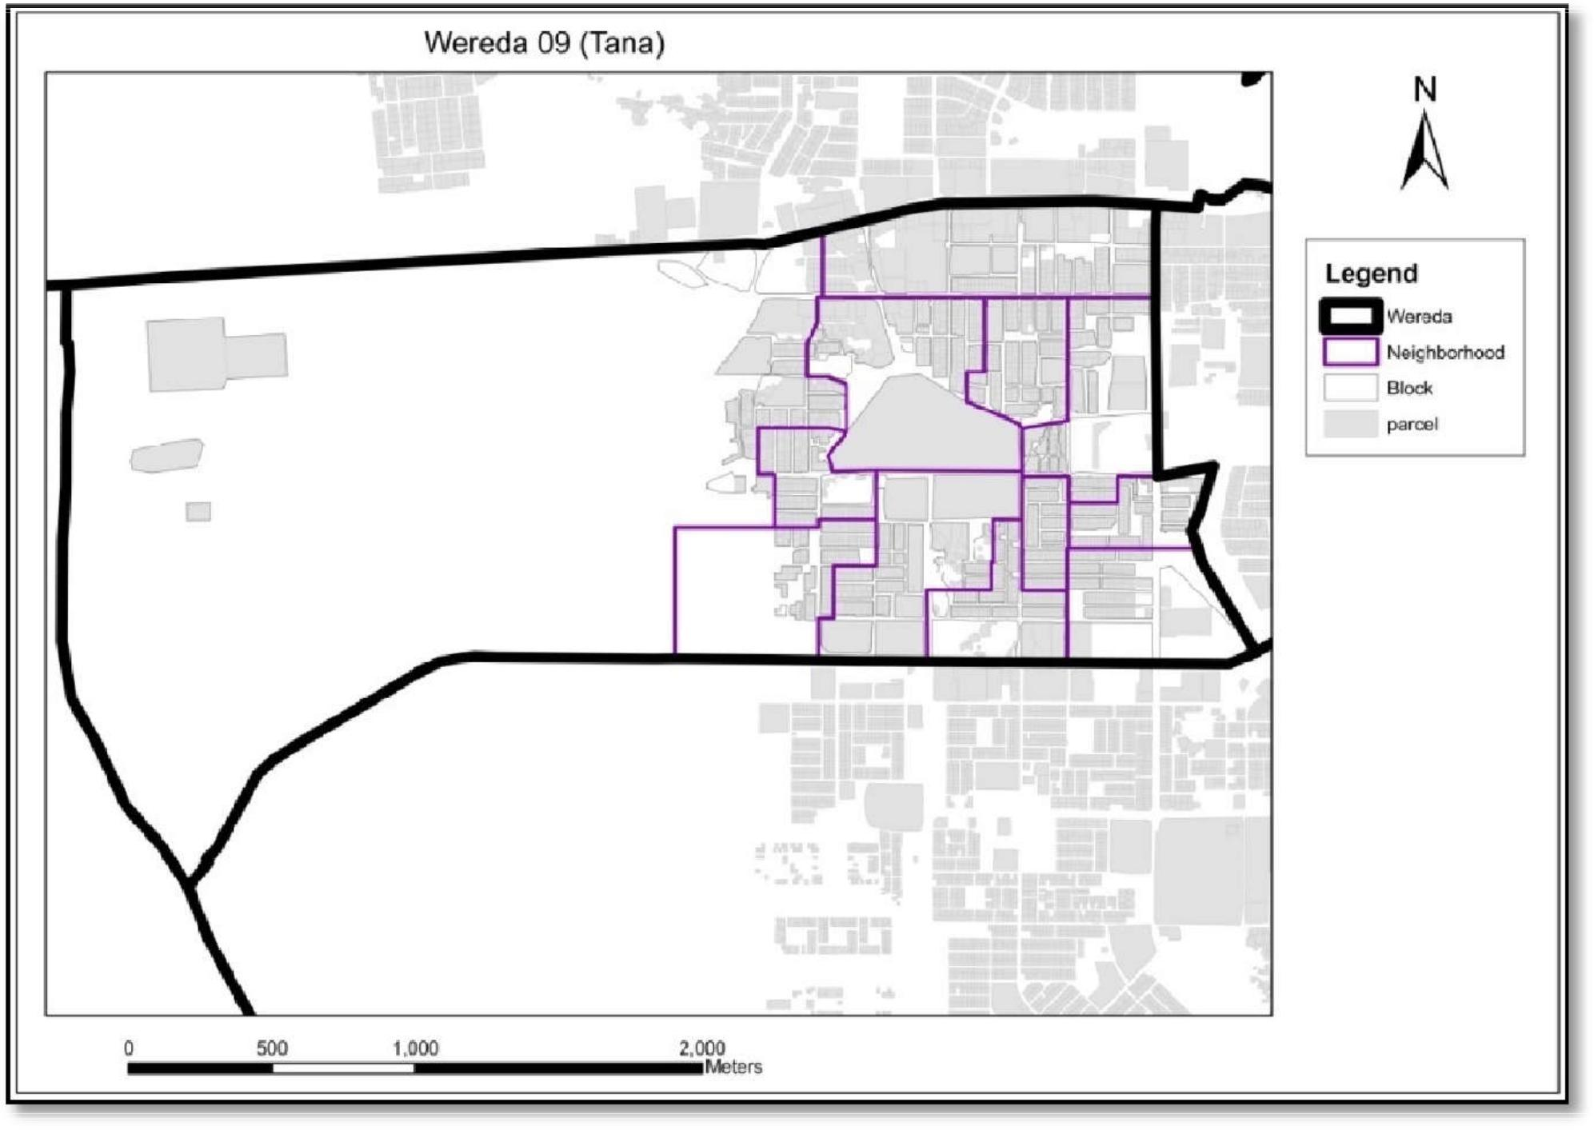
Sample Neighborhood level map for field verification

Slide 78
Examination and verification of vector data – cases???
If a parcel or a group of parcels on the vector file are well- captured during digitization, these parcels still need to be verified on the ground by the boundary demarcation team and approved by Cadastre officer.

Slide 79
Examination and verification of vector data – case 1
If the data brought by the demarcation team confirms the accuracy seen on the parcel data of cadastral base map, then that parcel or a group of parcels will be passed on to adjudication.

Slide 80
Examination and verification of vector data – case 2
If the data brought by the demarcation team indicates the need for slight modifications, then the parcel or the group of parcels will be modified
Splitting
Merging
moving vertices
…etc tasks on parcel vector
in office using GIS editing techniques as will be practiced during the training (see next slides)

Slide 81
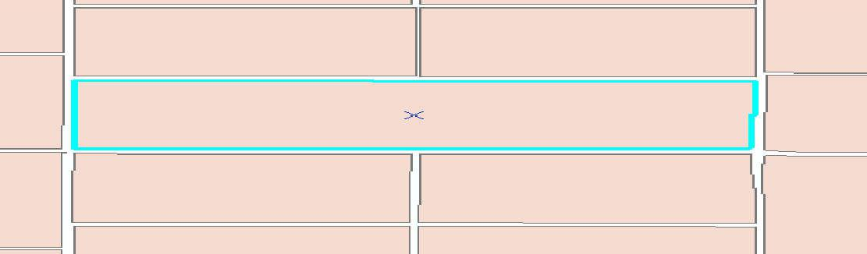
Feature splitting.
If certain parcel on the vector data becomes more than one, then the office surveyors shall confirm with the reality on the ground by sub dividing. Steps:
Use Editor tool in Arc Map and select the feature class you want to edit.

Slide 82
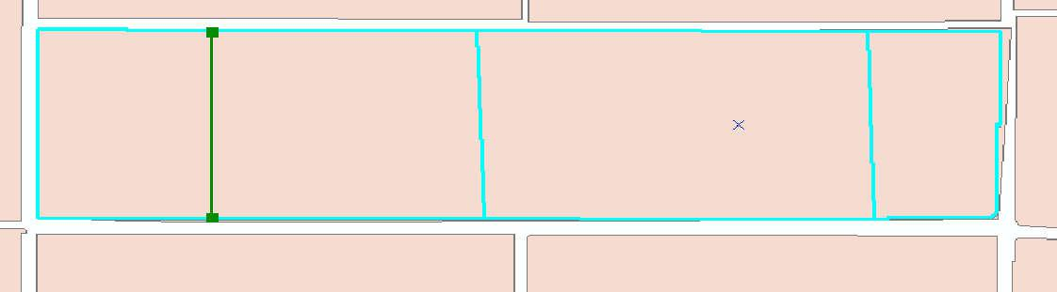
Feature splitting
Right-click the selected parcels and click construct from parent.
Use cut polygon tools to divide the selected parcel with straight segment.
The size of the subdivided parcels shall be based on the parcel standard of the area.

Slide 83
Feature splitting
Keeping the above case in the office, there may also be conditions for Ground Survey Work. Whenever there is a total shape mismatch1 between the vector parcel and the feature on the ortho-photo or if there is a total absence of a vector parcel feature from the vector dataset, the following procedures should be followed in collecting the parcel data.
Steps
The demarcation team verifies the existence of the parcel or a group of parcels on the ground and collects the relevant data.
Based on the data collected by the demarcation team, a field survey work is planned and conducted.

Slide 84
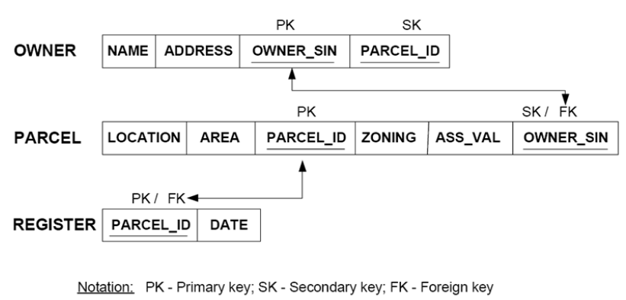

Slide 85
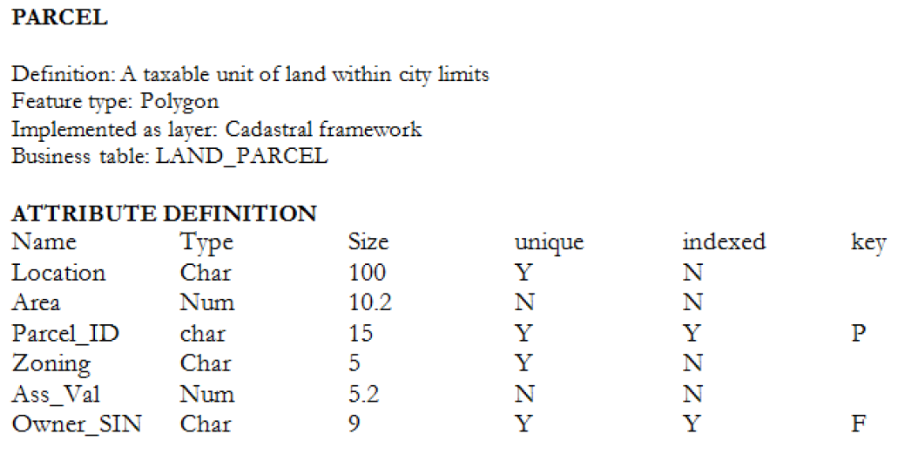

Slide 86
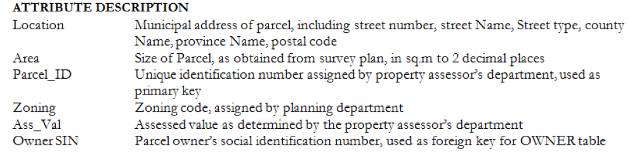

Slide 87
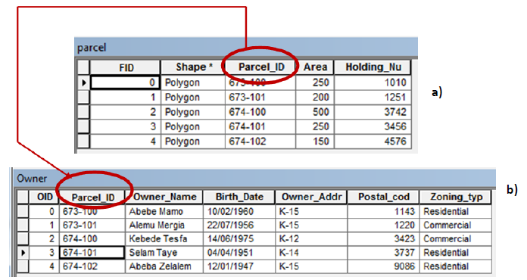

Slide 89
Basic of Onscreen Digitization
Cadastral Features Editing
(topics of upcoming sessions)

Slide 90
Basic of Onscreen Digitization
City (GDB)
Kebele
Ketena
Sefer
Block
Parcels
Orthophoto
→ Database structure created
Kebele Boundary imported
Survey data imported
Notes:
City (GDB)
Kebele
Ketena
Sefer
Block
Parcels

Slide 91
Advanced Cadastral Features Editing
Auto-complete Polygon
Snapping
Reshape
Vertex edit
Split & Merge

Slide 92
Topology
Avoid topological errors

Slide 93
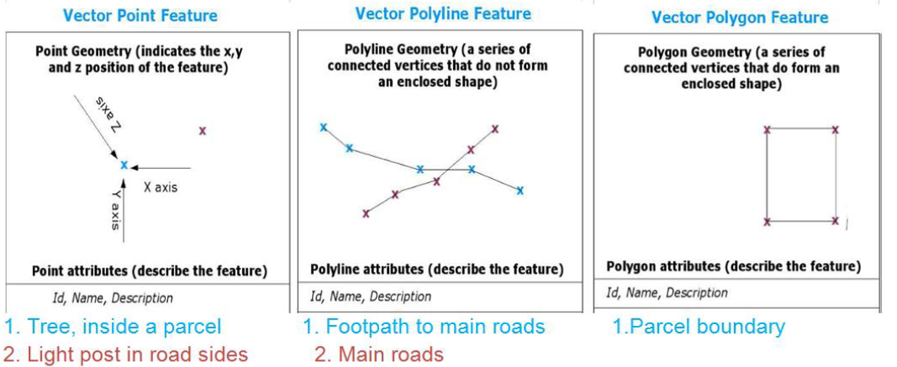
+

Slide 94
+

Slide 95
+

Slide 96
Topological errors
Undershoot
Overshoot
Dangling nodes

Slide 97
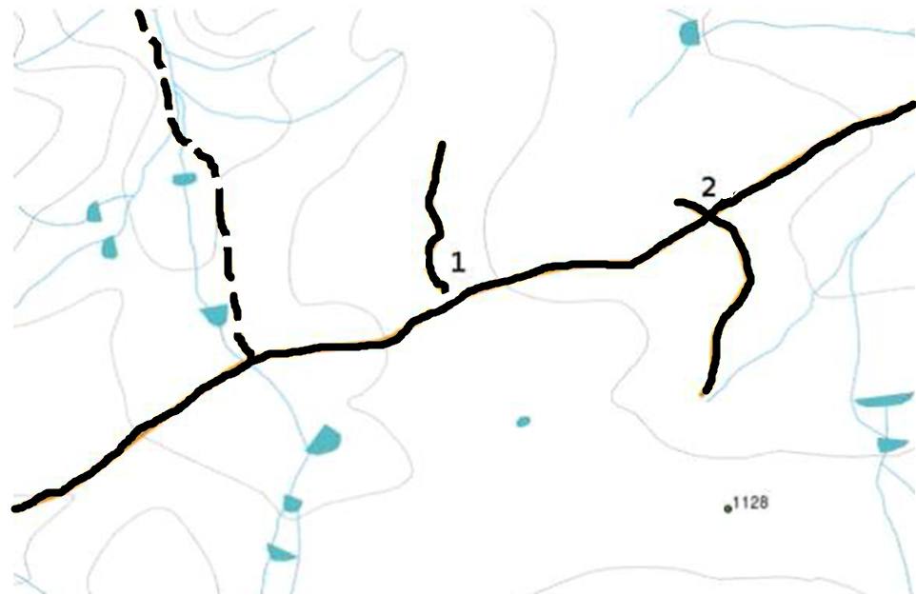
+

Slide 98
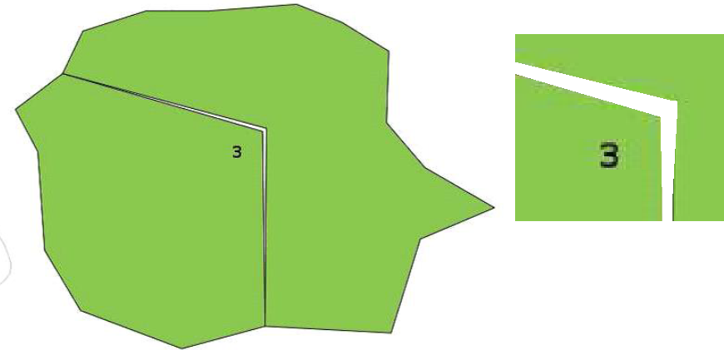

Slide 99
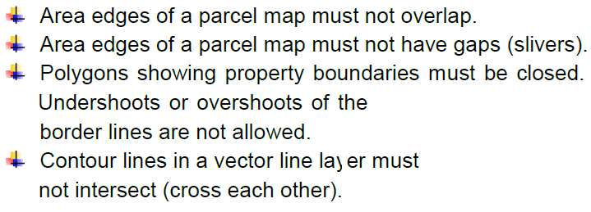
Topology rules

Slide 100
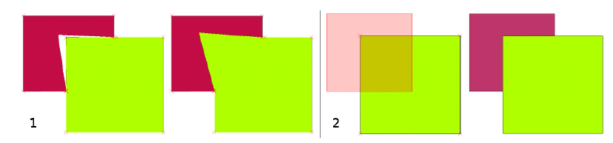

Slide 101
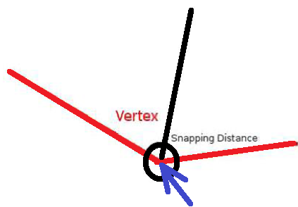
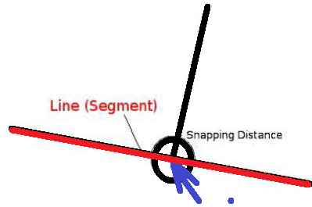
+

Slide 102
Sample geo-database template

Slide 103
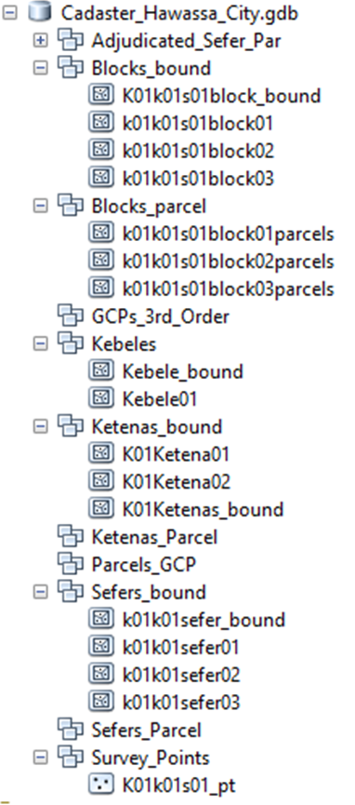

Slide 104
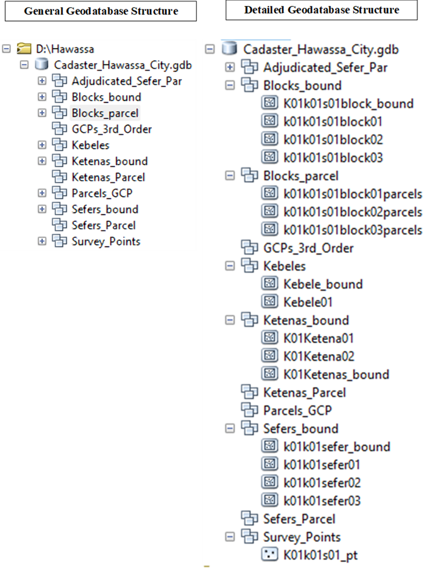

Slide 107
Modify the geodatabase
City Level
Kebele Level

Slide 108
Rules
One section has
Five Neighborhoods
One Neighborhood has
200 and below parcels
In One section there are
1000 and below parcels

Slide 109
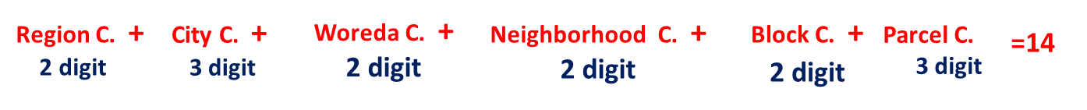
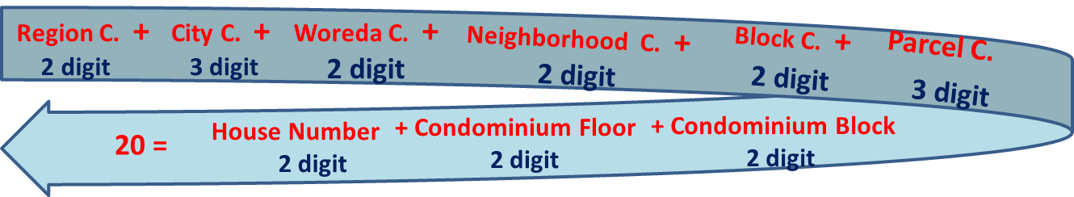
Rules As a national standard the UPIC shall hold the following form

